Slide 1
MSME Circle
A micro-mentoring platform for MSME entrepreneurs
Team - Sudo

Slide 2
Problem Statements
Information is siloed between companies due to language barriers and geographic locations
Stagnation of innovation and product completion due to insufficient knowledge and partner networks
The internet enabled technology disruption that happened in metros and tier-1 isn't happening in the tier 2,3 and 4 cities.
There are 50M SME's in india which makes the problem more worse resulting in unsolved problems.

Slide 3
Solution
A micro-mentoring platform for MSME entrepreneurs to discuss their problems and get advice from experienced mentor in that particular domain
A digital auto translate platform powered by Google Translate to solve the language issue between companies located in varied locations across India to enable seamless knowledge sharing
Cocreation and Coinnovation can be spurred by finding strategic partners in different sectors.

Slide 4
Why now?
Through GST, 25% of SME's have a digital footprint now and linked with the GST database as of April 2018
450mn Internet Users in 2018 and expecting 850mn+ internet users by 2022 with CAGR 17.2%
By 2021, 536mn Indian language users will be there compared to 199mn English Internet users
9 out of every 10 new internet users in India over the next 5 years are likely to be Indian language users

Slide 5
How? - Enter MSME Circle
70% of Indians consider local language digital content more reliable than English content so providing an interface to interact in Vernacular languages itself
Progressive Web apps are used to enable byte sized content for lower end mobile phones
Minimal UI/UX design to simplify the navigation within the web application
Using Firebase real-time database to enable seamless interactions

Slide 6
Business Model
There will be an internal ad network using carousel ads.
Premium content containing insights about that particular landscape can be given on a subscription based business model

Slide 7
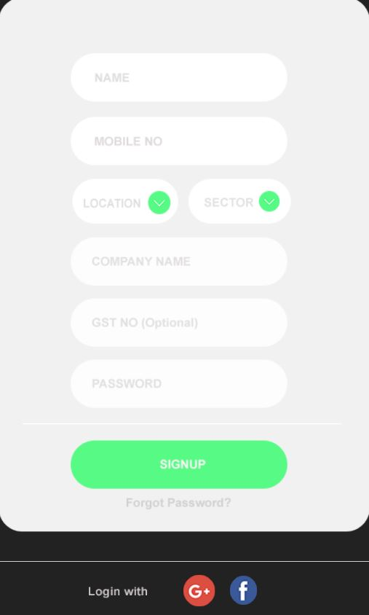
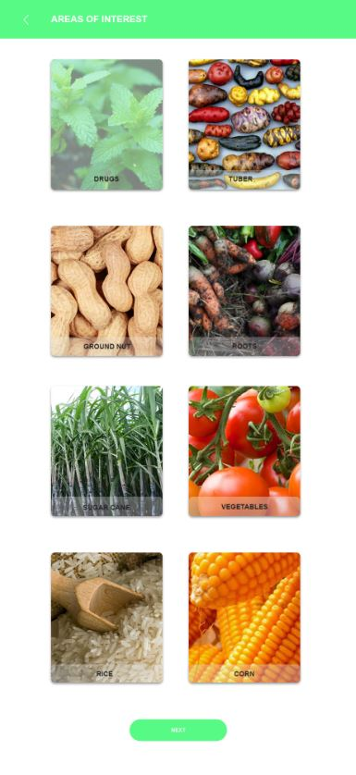
Screenshots

Slide 8
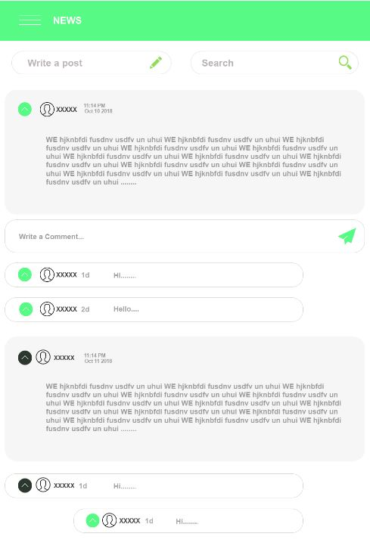
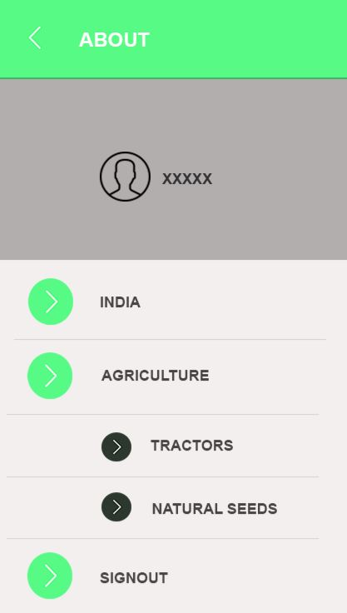

Slide 9
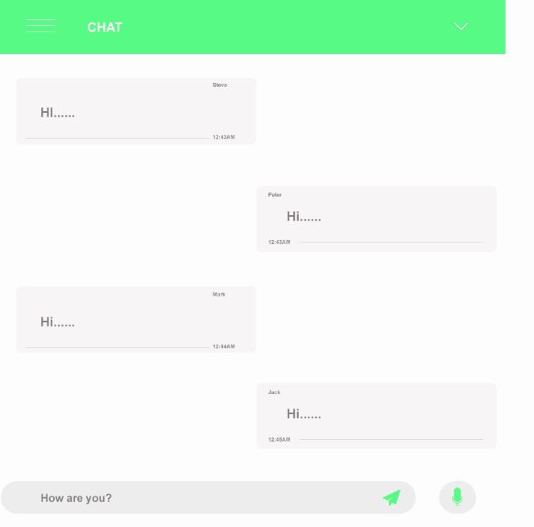
Thank You

